Slide 1
VISION-LANGUAGE MODELS
Lecture 4
VLMs for Image Understanding
in Practice

Slide 2
Vision-Language Models · L4: VLMs in Practice
Outline
I
The training pipeline
Pretrain → visual SFT → preference tuning: your LLM alignment knowledge, plus pixels
II
Capability summary
VQA · grounding and pointing · OCR and documents · charts · multi-image and GUI; dealing with image resolution
III
Benchmarks
VQAv2, MMMU, DocVQA, ChartQA: what each measures, what they don’t capture
IV
Hallucination
Why VLMs describe objects that aren't there — POPE, causes, mitigations
2

Slide 3
Vision-Language Models · L4: VLMs in Practice
Components of current production VLMs
ViT vision tower
native resolution
2D-RoPE (lecture 1) · window attn
MLP merger / projector
(Lecture 3's “simple interface”)
often merges 2×2 patches
LLM decoder
fine-tuned (noted in Lecture 3)
M-RoPE positions
text out — including
coordinates, JSON,
structured answers
Vision tower: contrastively/natively pretrained ViT — but with Lecture 1's Part-II upgrades in production: 2D rotary positions, variable input size, windowed attention for large images
Merger/projector: a small MLP — scaled up LLaVA design. Common trick to scale: aggregate 2×2 neighboring patch features → 4× fewer tokens at little cost
[NOTE: merger (also called projector) - we called this a bridge earlier, but this is the commonly used term in VLM papers]
LLM: open decoder (Qwen, InternLM, …) with Multimodal RoPE — positions factorized over (time, height, width);
Led to two VLM families, built around a common blueprint/design philosophy:
  Qwen-VL: tower + merger + LLM, then joint training
  InternVL: + adds native multimodal pretraining — BUT vision and language trained together from early on (not bolted on later)
We now consider how such production-scale “stacks” are trained and how performance is measured
Bai et al. 2025 (Qwen2.5-VL, arXiv:2502.13923); Zhu et al. 2025 (InternVL3, arXiv:2504.10479).
3

Slide 4
PART I
The training pipeline

Slide 5
Vision-Language Models · L4: VLMs in Practice
Three stages, common to VLM design
1 · MULTIMODAL PRETRAINING
billions of image-text tokens:
captions, interleaved web, OCR pairs
→ raw visual-linguistic knowledge
2 · VISUAL SFT
millions of curated (image,
instruction, response) samples
→ tasks, formats, conversation
3 · PREFERENCE TUNING
DPO/RLHF on chosen-vs-rejected
responses (incl. anti-hallucination)
→ judgment, honesty, style
Direct mapping to earlier LLM course:
pretrain → SFT → RLHF/DPO. Same algorithms; the data is where vision is integrated:
  Stage 1's scale dwarfs LLaVA's 595K: current reports describe corpora of hundreds of billions of multimodal tokens, mixing captions, interleaved documents, OCR, grounding, and synthetic data
  Stage 2 is supervised fine-tuning (SFT) against a “capability portfolio”, not a simple dataset like image/text pairs
  Stage 3 also injects a vision-specific objective: penalize confident descriptions of things that aren't in the image (anti-hallucination)
Training is often jointly done across stages' components: tower, merger, and LLM all unfrozen at some phase
— the notion of frozen capital (where we didn’t touch large pre-trained models’ weights) is dropped at production scale
Bai et al. 2025 §2–3; Zhu et al. 2025
5
Notes:
SFT = supervised fine tuning; See google books destroying books to scan them in ;’(
Production scale- the very large models that are used today (some with 100’s of millions to a billion dollar training costs).

Slide 6
Vision-Language Models · L4: VLMs in Practice
The VLM SFT portfolio: data type for model capabilities
data type | teaches | example sample
captioning / description | grounded fluent description | “Describe this image in detail.” → paragraph
VQA (natural + academic) | question answering, short-form accuracy | “What color is the umbrella?” → “red”
grounding / referring | localization; language↔space binding | “Find the man in the red shirt” → box coords
OCR & documents | reading text, layout, forms, receipts | “What is the invoice total?” → “R 228.13”
charts / tables / diagrams | structured visual reasoning | “Which quarter grew fastest?” → analysis
multi-image / interleaved | comparison, narrative across images | “What changed between these photos?”
GUI / screenshots (agentic) | UI understanding & action grounding | “Click the export button” → coordinates
text-only mixture | preserving pure language ability | (prevents forgetting — managed by injecting more text data)
Note: if a capability exists in a VLM, someone likely created data for it. Supposedly “Emergent” visual skills are mostly curated ones, as shown in this table (which continues to expand) — keep this in mind when a model seems magical (or when yours seem to lack a skill).
Composite of Qwen2.5-VL §2.2 and InternVL3 data mixture descriptions.
6

Slide 7
Vision-Language Models · L4: VLMs in Practice
Preference tuning with vision
Text mechanics you already know from LLMs:
collect (prompt, chosen, rejected) tuples; optimize with DPO or an RLHF reward model
What vision adds to the preference data (note: these are not official names!):
  “Faithfulness pairs”: chosen = describes only what's visible; rejected = believable but adds a plausible non-existent object (classic hallucination….)
  “Precision pairs”: chosen reads the actual number/text off a chart; rejected if simply estimates from prior info
  “Refusal pairs”: chosen says “the image doesn't show this” when it doesn’t; rejected when it does.
Why SFT alone can't fix hallucination:
SFT maximizes likelihood of good answers — it never shows the model a bad answer to move away from.
Preference tuning provides a “negative signal”
Fine-tuning schemes in VLM literature (just for info): LLaVA-RLHF, RLHF-V, plus large-scale in-house preference phases in the production reports (sadly the details of such methods are often very vague – proprietary? - compared to SFT)
We mention preference tuning since it will come up as hallucination mitigation in Part IV
Sun et al. 2023 (LLaVA-RLHF, arXiv:2309.14525); Yu et al. 2024 (RLHF-V, arXiv:2312.00849); Rafailov et al. 2023 (DPO, arXiv:2305.18290).
7

Slide 8
PART II
Core capability tour

Slide 9
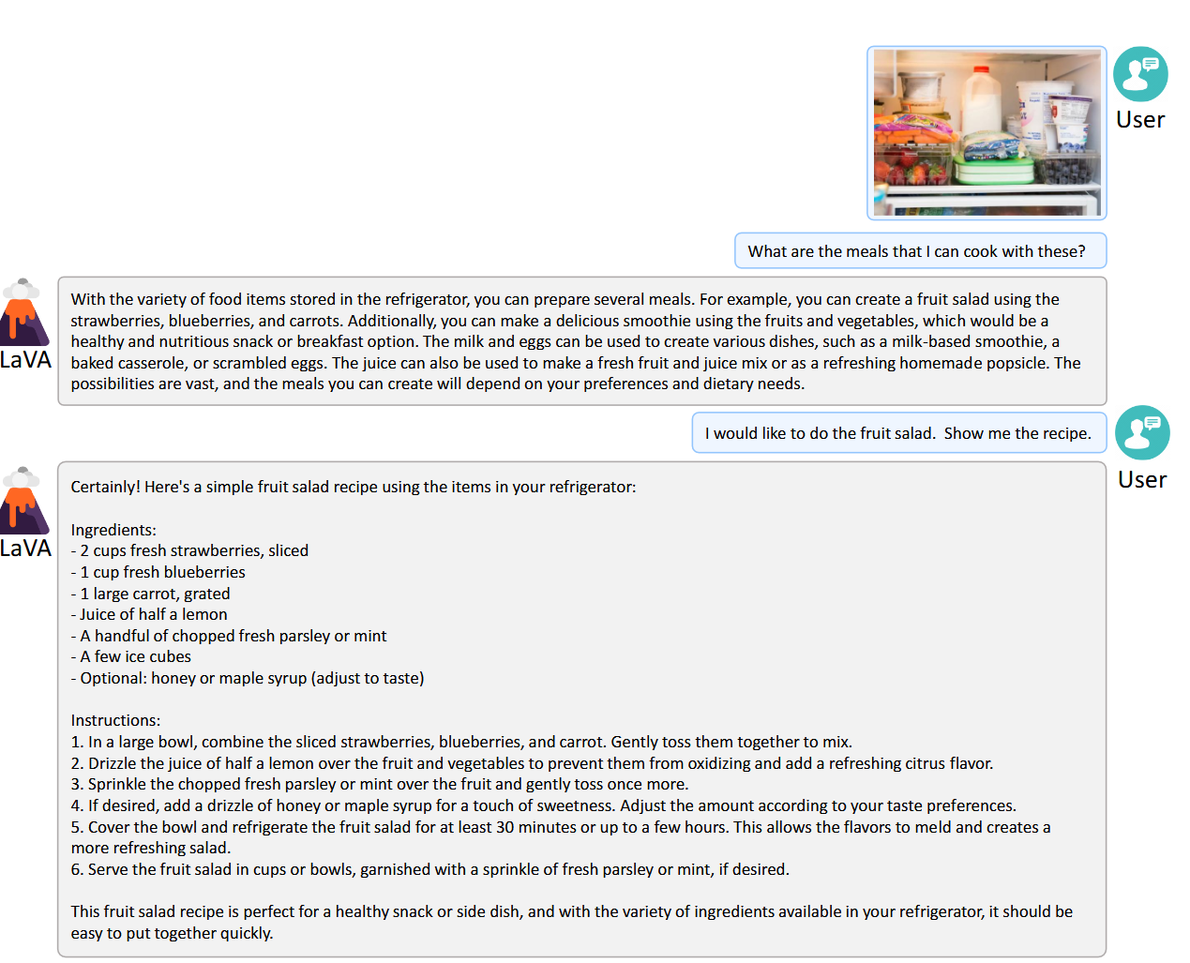
Vision-Language Models · L4: VLMs in Practice
Capability 1: open visual question answering
Most basic VLM capability : any question, grounded in the image, answered in a language
  Perception: “What breed is the dog?” · “What does the sign say?”
  Reasoning: “Why might the road be wet?” · “What happens next?”
  Knowledge fusion: “What landmark is this, and when was it built?” — pixels select the entity; the LLM's world knowledge provides the facts
What makes VQA deceptively hard to evaluate:
  Open-ended answers have many valid phrasings — benchmarks force short answers (Part III's VQAv2) or use LLM judges
  Many questions are answerable from language priors alone (“What color is the grass?”) . A model can score well while barely looking.
  This deficiency affects benchmarking and dealing with hallucinations (see later)
Antol et al. 2015 (VQA, arXiv:1505.00468); Goyal et al. 2017 (VQAv2, arXiv:1612.00837).
9

Slide 10
Vision-Language Models · L4: VLMs in Practice
Capability 2: (image) grounding — coordinates are just tokens
USER: Find every coffee cup. Report boxes as JSON.
MODEL: [{"label":"coffee cup","bbox":[712,418,864,590]}, {"label":"coffee cup","bbox":[1024,388,1189,566]}]
Key insight: bounding boxes and points are emitted as ordinary text tokens (numbers) — no object detection head or special architecture
  Made possible by M-RoPE anchoring positions to absolute image coordinates: the model knows where each patch is in pixels, so it can identify the location
  Current models ground in absolute pixel coordinates at native resolution — no need for old fixed image resize pipelines
Grounding Variants: referring (“the man in red” → box) · pointing (single click coordinates — point-based ground vs image box) · dense/open-vocabulary (“every vehicle”)
Important for later: an answer with coordinates is checkable: grounding is used to combat hallucination and enables selection for GUI agents (capability 6)
Peng et al. 2023 (Kosmos-2, arXiv:2306.14824); Bai et al. 2025 §2.3; Deitke et al. 2024 (Molmo/PixMo, arXiv:2409.17146).
10
Notes:
Grounding in this context: producing localization for some object/element in image either bounding box or point.

Slide 11
Vision-Language Models · L4: VLMs in Practice
Capability 3: OCR and document understanding
Range from “what does the sign say” to full document parsing:
  Reading: scene text, handwriting, multilingual, rotated/curved text (e.g,. scanned book pages)
  Structure: forms, invoices, tables → key-value extraction, often directly as JSON/HTML/markdown
  Long documents: multi-page contracts, papers — answer questions with page/region (where the source/origin is in input)
Why this was the hardest capability to earn:
  Text chars very small relative to the image — a 10px-tall character inside one 14px patch is at the edge of what we can resolve
  BLIP-2's 32-token bottleneck provably destroys this fine detail; Also, LLaVA's fixed 336px often destroys it too
  Solved by considering data and resolution:
  huge OCR corpora in pretraining and native-resolution towers — next slide show why native resolution is essential
Practical consequence of supporting this capability:
  “document AI” — processing/analyzing receipts, invoices, forms — is a flagship commercial VLM use case, measured by DocVQA
Mathew et al. 2021 (DocVQA, arXiv:2007.00398); Qwen2.5-VL §2.2 (document parsing data).
11

Slide 12
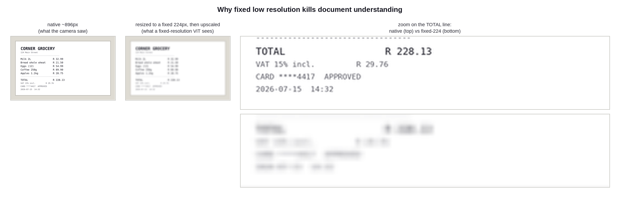
Vision-Language Models · L4: VLMs in Practice
Image resolution - part 1: what fixed resizing destroys
The TOTAL amount is unrecoverable in the 224px version — no vision model can read pixels that no longer exist. Fixed-resolution ViTs (using ViT 224/336 defaults) were designed for “what object is this”, rather than “what does line 9 say”.
12

Slide 13
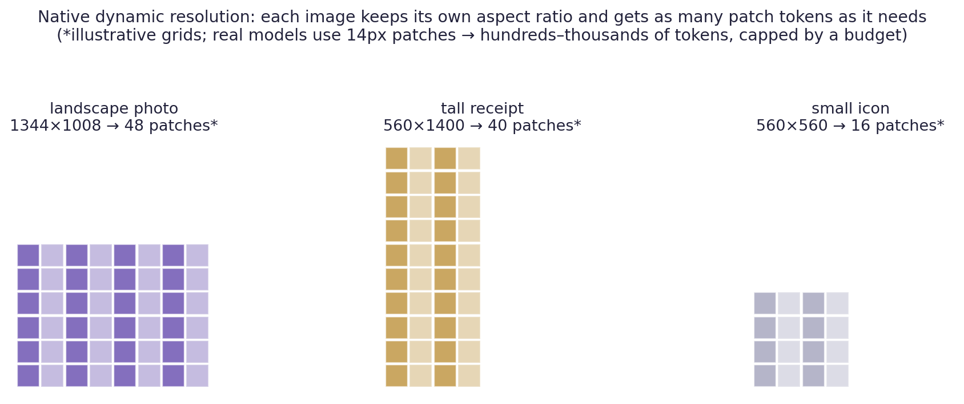
Vision-Language Models · L4: VLMs in Practice
Image resolution - part 2: native dynamic resolution
The current/modern approach (used in Qwen-VL etc): no fixed input size — patchify at native resolution and aspect ratio; token count varies per image under a budget cap
What is needed: 2D-RoPE position al encoding (no interpolation step needed — relative offsets generalize), windowed attention to keep O(n²) affordable on 3000-token (!) pages, and a 2×2 patch-merger to halve the sequence twice
Predecessor worth knowing: “AnyRes” tiling (LLaVA-NeXT) — chop the big image into fixed-size tiles + a thumbnail; simpler, but tile seams and redundant tokens. Native patching won
Rule of thumb: if your task involves reading, input the highest image resolution your budget allows — resolution is the “cheapest accuracy you can buy”
Bai et al. 2025 §2.1; Liu et al. 2024 (LLaVA-NeXT blog); Dehghani et al. 2023 (NaViT, arXiv:2307.06304).
13

Slide 14
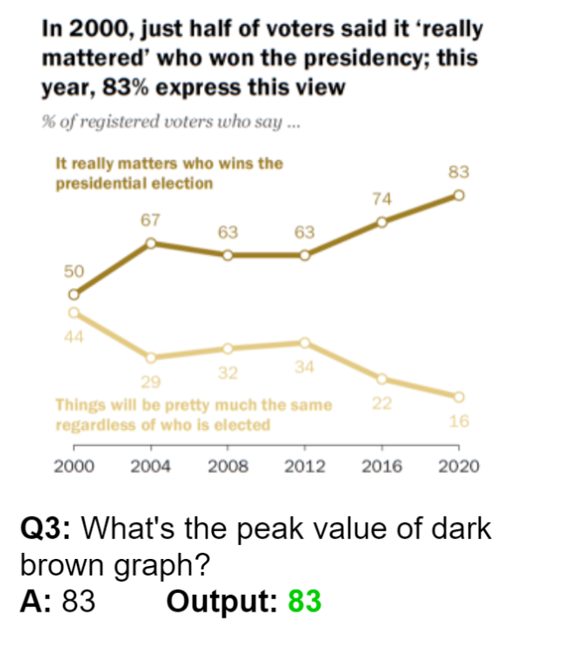
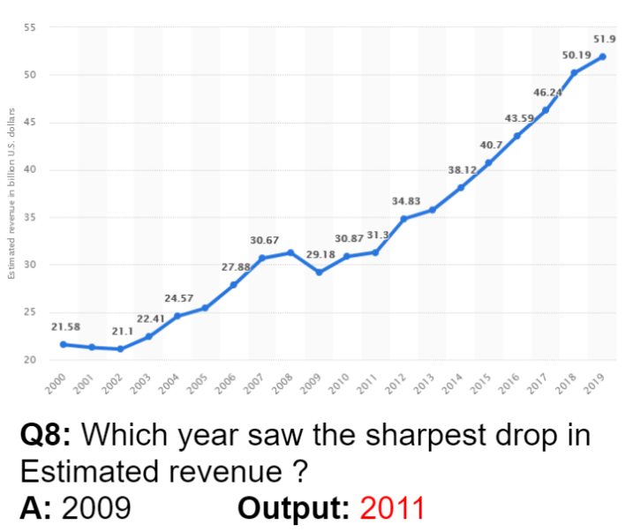
Vision-Language Models · L4: VLMs in Practice
Capability 4: charts, tables, and diagrams
A different skill from OCR: the marks/elements are machine readable, but the meaning is based in layout geometry and chart/table representation conventions
  Read exact values (bar heights, axis labels, legends) — must be accurate
  Analyze: “Which region grew fastest 2023→2025?” = read text, convert, recover numbers, subtract, compare
  Convert:
  chart → data table / JSON;
  flowchart → steps;
  schematic → explanation
Common failure mode— the model “knows” what a typical chart/element does from training and hallucinates an answer (issue: “priors over pixels”)
Benchmark: ChartQA ; the machine-generated vs human-written question split exposes template overfitting
As scientists this is relevant to us — e.g. automate extracting data from published figures. Verification needed: e.g. verifying totals by asking the model to also output the raw table, then spot-check. Don’t simply believe its right!
Masry et al. 2022 (ChartQA, arXiv:2203.10244).
14

Slide 15
Vision-Language Models · L4: VLMs in Practice
Capabilities 5 and 6: multi-image reasoning and GUI agents
Multi-image / interleaved input (Flamingo's format, now standard)
  Compare: “spot the differences”, before/after, best-of-N product photos
  Aggregate: answer a question whose evidence spans several images or pages
  To aggregate information across image sequence (image 1, then 2, then 3 etc), the images are treated as ‘video frames’ and M-RoPE (used for video) is used to allow system to determine which image a patch comes from which image (image 1, 2, 3 etc) and thus to reason coherently across all images (and associated text).
GUI understanding → computer-using agents
  Input: a screenshot. Skills: recognize widgets, read state, ground the next action (“click here” = pointing, capability 2!)
  Loop: screenshot → decide → act → new screenshot — a VLM in a control loop is an agent
Qwen2.5-VL §2.3 (agent capabilities); Hong et al. 2024 (CogAgent, arXiv:2312.08914).
15

Slide 16
Vision-Language Models · L4: VLMs in Practice
The “capability frontier”
reliable today | usable with care | still unreliable
describing scenes; common-object VQA | precise counting beyond ~5–10 | fine-grained spatial relations (“third from the left, behind…”)
printed-text OCR at native resolution | handwriting; dense multi-column layouts | very long documents end-to-end without retrieval help
single-object grounding / referring | exhaustive detection of MANY instances | pixel-perfect boxes rivaling specialist detectors
chart reading with visible values | multi-step numeric reasoning over charts | inferring values that need interpolation without hallucinating them
2–8 image comparison | dozens of images / long interleaving | consistent object identity tracking across many images
Snapshot as of mid-2026, moving fast — expect items to migrate left over time. Fort your work: place your task in this table before trusting outputs.
16

Slide 17
PART III
Benchmarks
How the field keeps score — and how scores mislead

Slide 18
Vision-Language Models · L4: VLMs in Practice
Common VLM benchmarks
benchmark | probes | what it misses | mitigation
VQAv2 (2017) | everyday perception QA | Many questions are guessable from language patterns alone (e.g. “grass is green”) without looking at the image. | Pairs each question with two images that have different correct answers, forcing real image use — though scores are now near saturation.
MMMU (2024) (Massive Multi-discipline Multimodal Understanding and Reasoning) | college-level multimodal reasoning, 6 disciplines | A meaningful share of items can be answered from general knowledge and elimination alone, without the image. | Compare against a text-only “blind” model on the same questions — the gap shows how much the image actually mattered.
DocVQA (2021) | document reading & layout | Tests extraction, not reasoning — scored by text-similarity to a reference answer (ANLS), not real understanding. | Treat a high score as “can locate a field,” not “can reason about the document.”
ChartQA (2022) | chart values + composition | Half the questions are auto-generated from fixed templates, which a model can pattern-match without truly reading the chart. | Compare the human-written and machine-generated splits separately — a big gap signals pattern-matching, not real skill.
MMBench / MMStar (MM=multimodal) | broad skill batteries | Models can favor a particular answer letter, or answer correctly without ever needing the image at all. | MMBench rotates the answer choices and requires every ordering correct; MMStar filters out questions that don't need the image.
POPE (2023) | object hallucination specifically | Only covers object presence — says nothing about the attribute or relation hallucination covered earlier in this lecture. | Use alongside a broader hallucination benchmark — don't treat POPE as the full hallucination picture.
Use appropriate benchmark, but watch out for the caveats. e.g. A doc-AI product cares about DocVQA; a tutor cares about MMMU; BUT all use cases should care about (the ;) POPE.
Goyal et al. 2017; Yue et al. 2024 (MMMU, arXiv:2311.16502); Mathew et al. 2021; Masry et al. 2022; Liu et al. 2023 (MMBench, arXiv:2307.06281); Chen et al. 2024 (MMStar, arXiv:2403.20330).
18
Notes:
Close variant – minor typos, small imperfections ‘almost correct’ – ‘exact-match-ish’

Slide 19
Vision-Language Models · L4: VLMs in Practice
Three ways scores mislead
1 · Blind solvability — the image isn't needed
  Diagnostic: give the same question to a strong text-only LLM with no image at all. On many “multimodal” benchmarks it still answers a large share correctly — using world knowledge and eliminating unlikely options, with no visual information (this motivated devlopment MMStar).
  Fix1: filter out what a “blind” model already solves: drop any question a text-only LLM gets right, since the image clearly wasn't required (how MMStar was built from MMBench).
  Fix2: balance the answers: VQAv2's original design pairs the same question with two different images that have two different correct answers, so ignoring the image is wrong half the time.
2 · Contamination — the test set is in the training set
  Web-scale pretraining crawls the open web, which increasingly contains the exact benchmark images and questions — sometimes with the answer nearby. A model that saw the test item during training scores well by memory, not “skill”.
  Mitigations: decontamination filters that scan training data for near-duplicates of benchmark items, private or periodically-refreshed test sets, and human-written question splits that are harder to scrape verbatim.
3 · Format gaming — MCQ position bias and prompt sensitivity
  Some models default toward a particular answer letter (e.g. always choosing “C”) regardless of what the options say. Circular evaluation catches this: MMBench asks the same question repeatedly with the choices shuffled into different orders, and only counts it correct if every ordering is right.
  Short-answer exact-match scoring has its own issues: it can mark a correct answer wrong just because it's phrased differently from the reference (e.g. “2” vs. “two”).
Always validate: when a model “beats humans” on a benchmark, consider if one or more of these three are inflating performance
Chen et al. 2024 (MMStar); Goyal et al. 2017 (VQAv2 balancing); Liu et al. 2023 (MMBench circular eval).
19

Slide 20
PART IV
Hallucination

Slide 21
Vision-Language Models · L4: VLMs in Practice
What hallucination looks like
image: a kitchen counter with a kettle and two mugs (no people, no food)
USER: Describe the image.
MODEL: A cozy kitchen scene. A kettle sits on the counter beside two mugs,
with a plate of cookies nearby, ready for an afternoon break.
“A plate of cookies”: consistent, plausible, contextually correct— and not in the image: object hallucination, most widely studied kind
Hallucination taxonomy:
object (things that aren't there)
attribute (wrong color/count/size)
relation (wrong spatial/interaction claims)
Very damaging to user trust: errors are confident and plausible — precisely the ones a human reviewer skims past. An unreliable-but-obvious failure is manageable, but these are not.
Hallucination is NOT:
  Refusing — the model says "I can't tell" or "there's nothing like that visible" → not hallucination, even though it declined to answer.
  Hedging — the model says "it might be a cookie, hard to tell" → not hallucination, because it flagged its own uncertainty instead of asserting it as fact.
  Misreading genuinely ambiguous pixels — the image actually contains something hard to make out (blurry, occluded, low-res), and the model guesses
  wrong about what that real, present thing is → a perception error, but not hallucination, because something was actually there — it just misidentified it.
Taxonomy after Rohrbach et al. 2018 (CHAIR, arXiv:1809.02156).
21

Slide 22
Vision-Language Models · L4: VLMs in Practice
Why hallucination happens: the language prior wins
Cause 1 — asymmetric priors: the LLM half carries billions of tokens of “how scenes usually are”; the visual evidence is a few hundred tokens. Under uncertainty, generation follows the stronger prior: kettles come with cookies
Cause 2 — co-occurrence statistics in training data: captions mention objects together (kitchen→food, street→cars). The model learns P(mention | context), not P(IsPresent | pixels)
Cause 3 — SFT never says no: likelihood-based training on good captions rewards “fluent completeness”; there is no gradient against adding one plausible extra object
Cause 4 — attention dilution over long generations: late in a long description, attention to image tokens measurably decays; the model increasingly conditions on its own text (“snowballing”)
The above implies that: hallucination should be worst for objects that frequently co-occur with the scene but are absent — exactly what POPE's adversarial split tests → next
Li et al. 2023 (POPE, arXiv:2305.10355) §1–2; Rohrbach et al. 2018; Huang et al. 2024 (OPERA, arXiv:2311.17911) on attention decay.
22
Notes:
“fluent completeness” – the addition is plausible and often occurs in that context

Slide 23
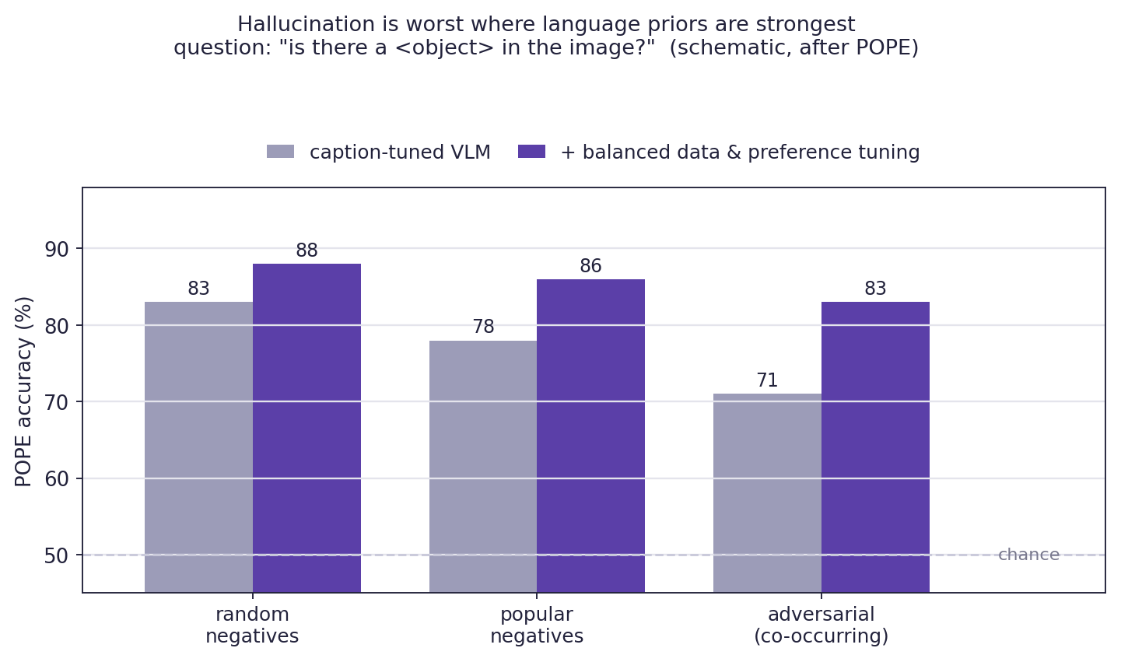
Vision-Language Models · L4: VLMs in Practice
Measuring Hallucination
POPE - Polling-based Object Probing Evaluation
Protocol: ask ONLY yes/no questions — “Is there a <object> in the image?” — half about present objects, half about absent ones
Three ways to choose the absent objects:
  random — any object
  popular — frequent dataset objects
  adversarial — objects that co-occur with what's present (cookies for kitchens)
Core findings
Accuracy falls as negatives get harder to reject: random negatives (any absent object) are easy to correctly deny; adversarial negatives are the hardest — accuracy declines steadily random → popular → adversarial.
Contextual failure: the model isn't getting worse everywhere, only where denying the object means overriding a strong contextual expectation.
Models lean towards "yes": even on easy random-negative questions, models answer "yes, it's there" more often than a pixel-driven, unbiased model should.
Why yes/no polling instead of judging captions?:
-> it isolates the model assertions made based on perception (vision) from caption fluency, length, and phrasing — simple and easy to interpret.
Note 1: Newer H-POPE – gives more nuanced evaluation of hallucination
Note 2: CHAIR - Caption Hallucination Assessment with Image Relevance- metric evaluates caption specific hallucination.
Li et al. 2023 (POPE, arXiv:2305.10355).
23
Notes:
Fluency = how well does txt fit? How plausible is it on this context?
Figure is representative (faked!) shows observed trend in experiments.

Slide 24
Vision-Language Models · L4: VLMs in Practice
Mitigating Hallucinations: four levers
lever | idea | cost / limits
data balance | include negatives (“no cookies here”), counterexamples that break co-occurrence, refusal samples | curation effort; must cover the prior's blind spots
preference tuning | chosen = faithful, rejected = hallucinated; RLHF-V-style fine-grained corrections | needs good pairs; can over-suppress and lead to timid answers (not willing to answer assertively)
decoding-time fixes (no retraining) | “contrastive decoding vs a distorted-image run” (VCD); penalize attention-decay patterns (OPERA) (this is just for information – just be aware that inference time mitigation exists) | inference overhead (multiple inference passes); treats symptoms, just suppresses prior issue (no fix via training)
grounded output formats | Force support for image content clam: not just "there's a laptop on the table," but the bounding box for where that laptops using box coordinate tokens. Also for reasoning about image elements that must be extracted and interpreted: charts etc | A model can still confidently emit a box in wrong place for an object that isn't there, so process/person downstream still has to verify the box actually matches real image content. Only works for claims that are spatially localizable, so "this looks like a birthday party" can't be handled this way.
Hallucination still a big issue: mitigated, not solved — the language prior is also what makes the model smart, so you can't just delete it. Current best practice utilizes all four levers and reports POPE/CHAIR alongside capability scores.
Leng et al. 2024 (VCD, arXiv:2311.16922); Huang et al. 2024 (OPERA); Yu et al. 2024 (RLHF-V); Sun et al. 2023 (LLaVA-RLHF).
24

Slide 25
Vision-Language Models · L4: VLMs in Practice
Practical guidance to avoid VLM hallucination
Maximize input image resolution— if the task involves reading anything, use the highest resolution the model/budget allows Make claims checkable — ask for boxes, coordinates, or verbatim quotes with locations; a claim you can't localize is a claim you can't trust
Separate perception from reasoning — first “list exactly what you can see”, then reason over that list; merging these operations can allow the learned LLM prior to fill gaps
Interrogate absences directly — “Is there X? Answer only from visible evidence; say no if absent.”
(Essentially running your own tiny POPE evaluation)
Ask twice, differently — rephrase and check consistency; hallucinations are often quite unstable and may appear/disappear depending on phrasing
Match the task to the frontier table (slide 16) — “usable with care” means you need to be vigilant and check outputs
25

Slide 26
Summary
Pipeline
Pretrain → visual SFT → preference tuning: LLM alignment stack, with vision-specific data at every stage. Capabilities are data line-items; “emergent” skills are mostly curated ones.
Capabilities
VQA, grounding-as-text-tokens, OCR/documents, charts, multi-image, GUI agents. Favour native dynamic resolution + the advanced positional encoding — resolution is the cheapest accuracy you can buy.
Benchmarks
Check the profile, not one number. Interrogate every score for “blind” solvability, contamination, and format gaming — MMStar and circular evaluation exist because naive scores are misleading.
Hallucination
The language prior outweighs a few hundred visual tokens; SFT never says no. POPE quantifies it (worst on co-occurring absences); mitigation combines data balance, preference tuning, decoding fixes, and grounded outputs.

Slide 27
Vision-Language Models · L4: VLMs in Practice
Resources
Paper references/reports
  Bai et al. (2025). Qwen2.5-VL Technical Report. arXiv:2502.13923 · Zhu et al. (2025). InternVL3. arXiv:2504.10479 — and the newest reports in each family (check the course page for this term's pinned versions)
  Peng et al. (2023). Kosmos-2. arXiv:2306.14824 · Deitke et al. (2024). Molmo & PixMo. arXiv:2409.17146 · Dehghani et al. (2023). NaViT. arXiv:2307.06304 · Hong et al. (2024). CogAgent. arXiv:2312.08914
  Goyal et al. (2017). VQAv2. arXiv:1612.00837 · Yue et al. (2024). MMMU. arXiv:2311.16502 · Mathew et al. (2021). DocVQA. arXiv:2007.00398 · Masry et al. (2022). ChartQA. arXiv:2203.10244 · Chen et al. (2024). MMStar. arXiv:2403.20330
  Li et al. (2023). POPE. arXiv:2305.10355 · Rohrbach et al. (2018). CHAIR. arXiv:1809.02156 · Sun et al. (2023). LLaVA-RLHF. arXiv:2309.14525 · Yu et al. (2024). RLHF-V. arXiv:2312.00849 · Leng et al. (2024). VCD. arXiv:2311.16922 · Huang et al. (2024). OPERA. arXiv:2311.17911
Code to try:
  Run a current open VLM from the HF Hub on one of your photos + one receipt. Compare answers at two resolutions.
27

